Slide 1




Multidimensional Arrays, Sets, Dictionaries
Processing Matrices, Multidimensional Arrays,
Dictionaries, Sets
Advanced C#
SoftUni Team
Technical Trainers
Software University
http://softuni.bg

Slide 2


Table of Contents
Matrices and Multidimensional Arrays
Jagged Arrays (arrays of arrays)
Sorting Arrays
Dictionaries – Dictionary<K, V>
Sets – HashSet<T>, SortedSet<T>

Slide 3
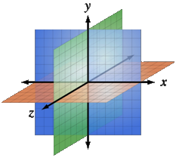
Multidimensional Arrays
Using Array of Arrays, Matrices
and Cubes

Slide 4
What is Multidimensional Array?
Multidimensional arrays have more than one dimension
The most used multidimensional arrays are the 2-dimensional
Known as matrices or tables
0 1 2
0
1
2
4 | 6 | 3
2 | 1 | 2
6 | 7 | 9
One main array whose elements are arrays

Slide 5
Declaring and Creating Multidimensional Arrays
Declaring multidimensional arrays:
Creating a multidimensional array
Use new keyword
Must specify the size of each dimension
int[,] intMatrix;
float[,] floatMatrix;
string[,,] strCube;
int[,] intMatrix = new int[3, 4];
float[,] floatMatrix = new float[8, 2];
string[,,] stringCube = new string[5, 5, 5];

Slide 6
Initializing Multidimensional Arrays
Initializing with values multidimensional array:
Matrices are represented by a list of rows
Rows consist of list of values
The first dimension comes first, the second comes next (inside the first)
int[,] matrix =
{
{1, 2, 3, 4}, // row 0 values
{5, 6, 7, 8} // row 1 values
};

Slide 7
Accessing Elements
Accessing N-dimensional array element:
Getting element value example:
Setting element value example:
nDimensionalArray[index₁, … , index_{n}]
int[,] array = {{1, 2}, {3, 4}}
int element11 = array[1, 1]; // element11 = 4
int[,] array = new int[3, 4];
for (int row = 0; row < array.GetLength(0); row++)
for (int col = 0; col < array.GetLength(1); col++)
array[row, col] = row + col;

Slide 8
Reading a Matrix – Example
int rows = int.Parse(Console.ReadLine());
int columns = int.Parse(Console.ReadLine());
int[,] matrix = new int[rows, columns];
for (int row = 0; row < rows; row++)
{
for (int column = 0; column < cols; column++)
{
Console.Write("matrix[{0},{1}] = ", row, column);
string inputNumber = Console.ReadLine();
matrix[row, column] = int.Parse(inputNumber);
}
}

Slide 9
Printing Matrix – Example
int[,] matrix =
{
{ 5, 2, 3, 1 },
{ 1, 9, 2, 4 },
{ 9, 8, 6, 11 }
};
for (int row = 0; row < matrix.GetLength(0); row++)
{
for (int col = 0; col < matrix.GetLength(1); col++)
{
Console.Write("{0} ", matrix[row, col]);
}
Console.WriteLine();
}
Gets length of 0th dimension (rows)
Gets length of 1st dimension (columns)

Slide 10

Reading and Printing Matrices
Live Demo

Slide 11
Maximal Platform – Example
Finding maximal sum of 2x2 platform
int[,] matrix = {
{7, 1, 3, 3, 2, 1},
{1, 3, 9, 8, 5, 6},
{4, 6, 7, 9, 1, 0} };
int bestSum = int.MinValue;
for (int row = 0; row < matrix.GetLength(0) - 1; row++)
for (int col = 0; col < matrix.GetLength(1) - 1; col++)
{
int sum = matrix[row, col] + matrix[row, col + 1] + matrix[row + 1, col] + matrix[row + 1, col + 1];
if (sum > bestSum)
bestSum = sum;
}

Slide 12

Maximal Platform
Live Demo

Slide 13


Matrix Multiplication
Live Demo

Slide 14

Exercises in Class

Slide 15
Snake Matrix
Write a program that generates a snake-like NxM matrix:
1 | 2 | 3
6 | 5 | 4
7 | 8 | 9
12 | 11 | 10
4 x 3 =>

Slide 16

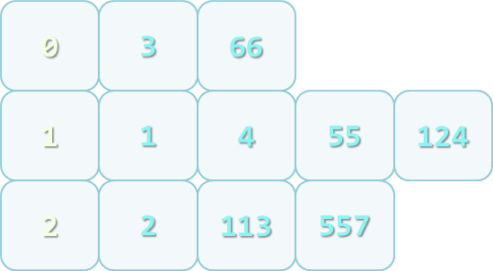
Jagged Arrays
What are Jagged Arrays and How to Use Them

Slide 17
Jagged Arrays
Jagged arrays are multidimensional arrays
But each dimension has different size
A jagged array is an array of arrays
Each of the arrays has different length
 | 0 | 1 | 2 | 3
0 | 7 | 3 | 4 | 2
1 | 5 | 1
2 | 9 | 3 | 1
int[][] jagged = new int[3][];
jagged[0] = new int[3];
jagged[1] = new int[2];
jagged[2] = new int[5];

Slide 18
Filling a Jagged Array
int[][] jagged = new int[5][];
for (int i = 0; i < jagged.GetLength(0); i++)
{
string[] inputNumbers = Console.ReadLine().Split(' ');
jagged[i] = new int[inputNumbers.Length];
for (int j = 0; j < jagged.GetLength(1); j++)
{
jagged[i][j] = int.Parse(inputNumbers[j]);
}
}

Slide 19
Example of Jagged Arrays
Read a set of numbers and group them by their remainder when dividing to 3 (0, 1 and 2)
1, 4, 113, 55, 3, 1, 2, 66, 557, 124, 2

Slide 20
Example of Jagged Arrays
int[] numbers = { 1, 4, 113, 55, 3, 1, 2, 66, 557, 124, 2 };
int[] sizes = new int[3];
int[] offsets = new int[3];
foreach (var number in numbers)
{
int remainder = number % 3;
sizes[remainder]++;
}
int[][] numbersByRemainder =
{ new int[sizes[0]], new int[sizes[1]], new int[sizes[2]] };
foreach (var number in numbers)
{
int remainder = number % 3;
int index = offsets[remainder];
numbersByRemainder[remainder][index] = number;
offsets[remainder]++;
}

Slide 21
Remainders of 3
Live Demo

Slide 22
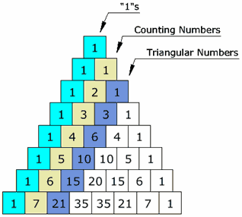
Pascal's Triangle
Live Demo

Slide 23
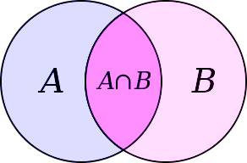
Sets
HashSet<T> and SortedSet<T>

Slide 24
Sets in C#
A set keep unique elements
Provides methods for adding/removing/searching elements
Offers very fast performance
HashSet<T>
Keeps a set of elements in a hash-tables
The elements are randomly ordered (by their hash code)
SortedSet<T>
Keeps a set of elements in a red-black ordered search tree
The elements are ordered incrementally

Slide 25
HashSet<T> – Example
HashSet<string> set = new HashSet<string>();
set.Add("Pesho");
set.Add("Pesho");
set.Add("Gosho");
set.Add("Alice");
Console.WriteLine(string.Join(" ", set));
// Pesho Gosho Alice
Console.WriteLine(set.Contains("Georgi")); // false
Console.WriteLine(set.Contains("Pesho")); // true
set.Remove("Pesho");
Console.WriteLine(set.Count); // 2

Slide 26
SortedSet<T> – Example
SortedSet<string> set = new SortedSet<string>();
set.Add("Pesho");
set.Add("Pesho");
set.Add("Pesho");
set.Add("Gosho");
set.Add("Maria");
set.Add("Alice");
Console.WriteLine(string.Join(" ", set));
// Alice Gosho Maria Pesho
Keeps the elements sorted

Slide 27
HashSet<T> and SortedSet<T>
Live Demo

Slide 28
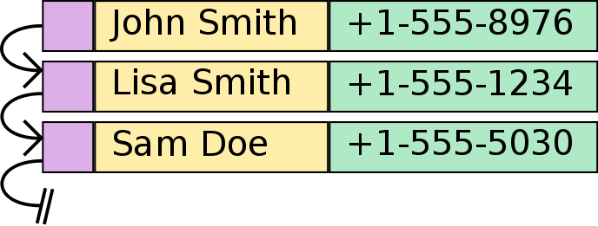
Associative Arrays
Dictionary<Key, Value>

Slide 29
Associative Arrays (Maps, Dictionaries)
Associative arrays are arrays indexed by keys
Not by the numbers 0, 1, 2, …
Hold a set of pairs <key, value>
Traditional array
Associative array
key
value
key
0 1 2 3 4
John Smith | +1-555-8976
Lisa Smith | +1-555-1234
Sam Doe | +1-555-5030
value
8 | -3 | 12 | 408 | 33

Slide 30
Phonebook – Example
Dictionary<string, string> phonebook =
new Dictionary<string, string>();
phonebook["John Smith"] = "+1-555-8976";
phonebook["Lisa Smith"] = "+1-555-1234";
phonebook["Sam Doe"] = "+1-555-5030";
phonebook["Nakov"] = "+359-899-555-592";
phonebook["Nakov"] = "+359-2-981-9819";
phonebook.Remove("John Smith");
foreach (var pair in phonebook)
{
Console.WriteLine("{0} --> {1}", entry.Key, entry.Value);
}

Slide 31
Events – Example
SortedDictionary<DateTime, string> events =
new SortedDictionary<DateTime, string>();
events[new DateTime(1998, 9, 4)] = "Google's birth date";
events[new DateTime(2013, 11, 5)] = "SoftUni's birth date";
events[new DateTime(1975, 4, 4)] = "Microsoft's birth date";
events[new DateTime(2004, 2, 4)] = "Facebook's birth date";
events[new DateTime(2013, 11, 5)] =
"Nakov left Telerik Academy to establish SoftUni";
foreach (var entry in events)
{
Console.WriteLine("{0:dd-MMM-yyyy}: {1}",
entry.Key, entry.Value);
}

Slide 32
Dictionary<K, V> and SortedDictionary<K, V>
Implemented as a hash table
Have property Count – the number of key-value pairs
Keys – a collection of all keys
Values – a collection of all values
Basic operations – Add(), Remove(), Clear()
Boolean methods:
ContainsKey() – checks if a key is present in the dictionary
ContainsValue() – checks if a value is present in the dictionary

Slide 33
Associative Arrays
Live Demo

Slide 34

Summary
Multidimensional arrays have more
than one dimension
Two-dimensional arrays are like tables
with rows and columns
Jagged arrays are arrays of arrays – each element is an array itself
The HashSet<T> and SortedSet<T> hold unique elements and are very fast
Dictionary<K, V> is an associative array where a value is accessed by its key

Slide 35









Multidimensional Arrays, Sets, Dictionaries
https://softuni.bg/courses/advanced-csharp

Slide 36

License
This course (slides, examples, demos, videos, homework, etc.) is licensed under the "Creative Commons Attribution-NonCommercial-ShareAlike 4.0 International" license
Attribution: this work may contain portions from
"C# Fundamentals – Part 1" course by Telerik Academy under CC-BY-NC-SA license
"C# Fundamentals – Part 2" course by Telerik Academy under CC-BY-NC-SA license

Slide 37






Free Trainings @ Software University
Software University Foundation – softuni.org
Software University – High-Quality Education, Profession and Job for Software Developers
softuni.bg
Software University @ Facebook
facebook.com/SoftwareUniversity
Software University @ YouTube
youtube.com/SoftwareUniversity
Software University Forums – forum.softuni.bg

